Slide 1

BlitsMe
Typical Scenario Walkthrough

Slide 2
User A contacts a supporter (User B)
Describes the problem
User B requests access to A’s Desktop

Slide 3
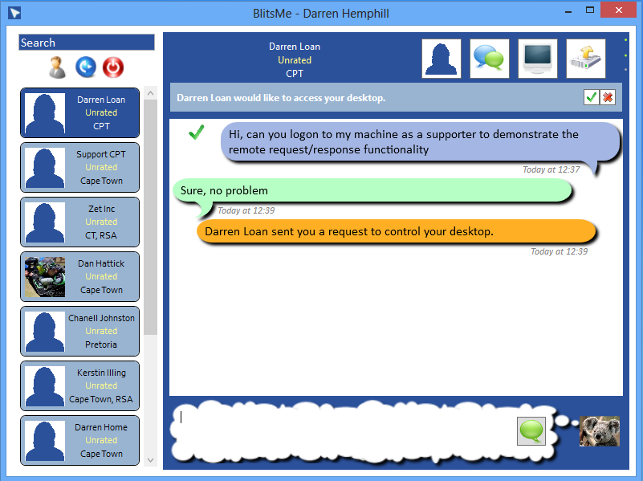

Slide 4
User A clicks Accept
Screen goes red as the supporter logs on

Slide 5
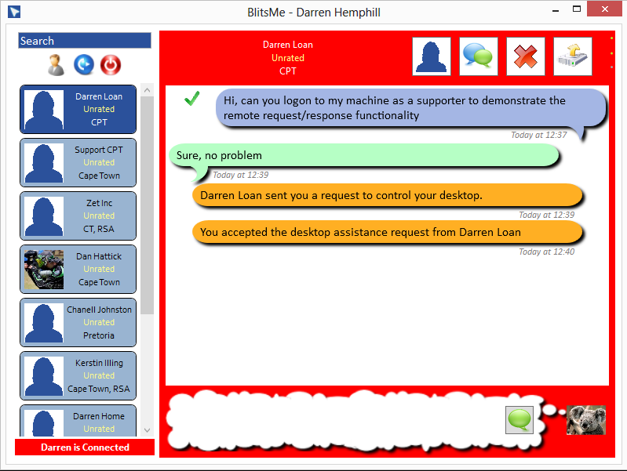
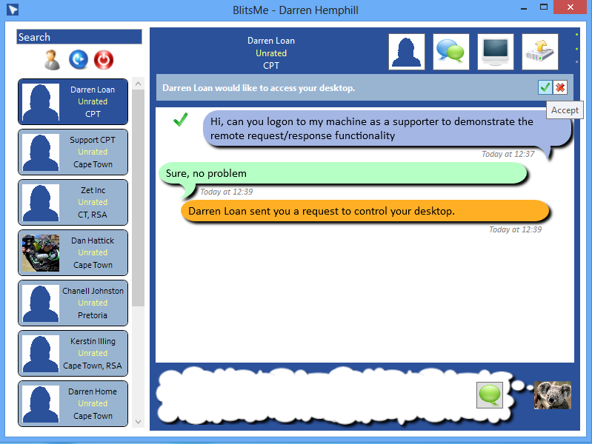

Slide 6
Supporter performs work and disconnects
OR
User A can disconnect supporter via Disconnect button
User A then rates the supporter for their work

Slide 7
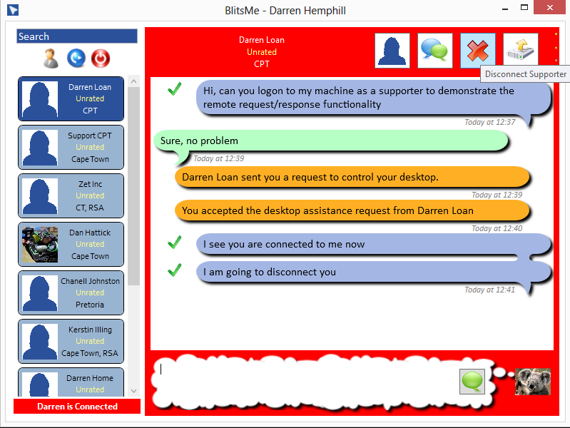
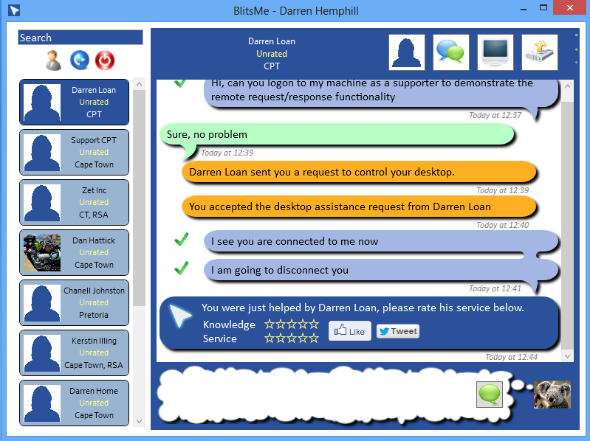

Slide 8
User A as the Supporter
User A offers support via Remote Desktop Button
User B accepts
User A gets a Remote Support Window onto User B’s Desktop

Slide 9
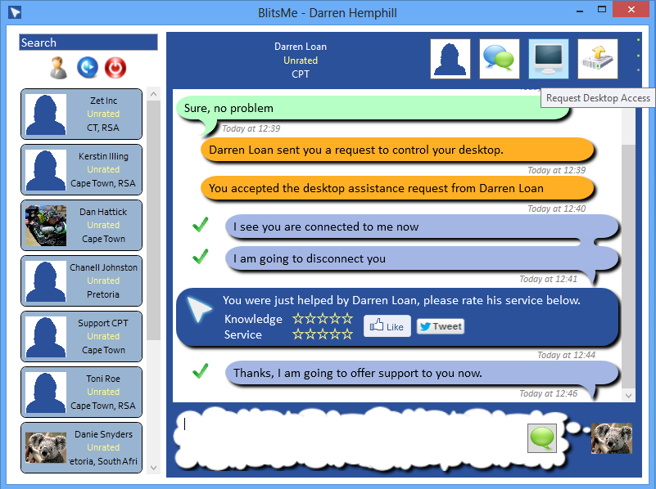
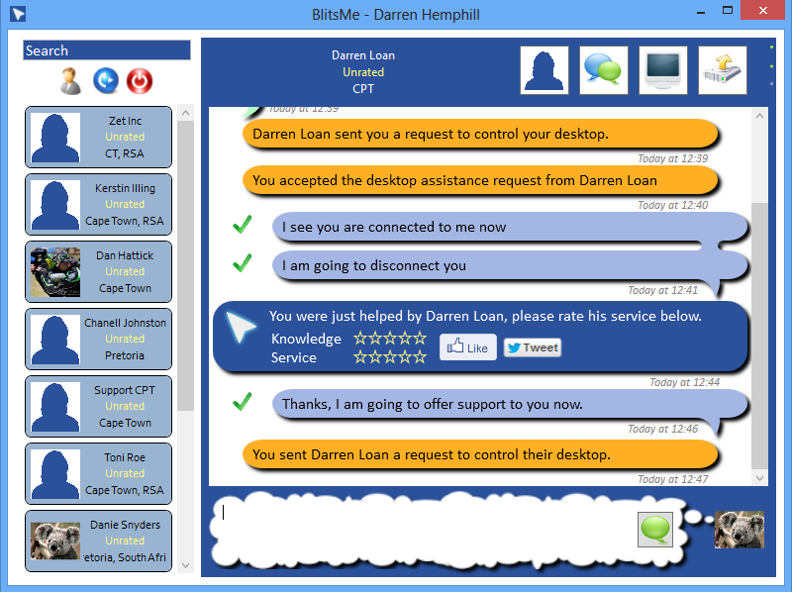

Slide 10
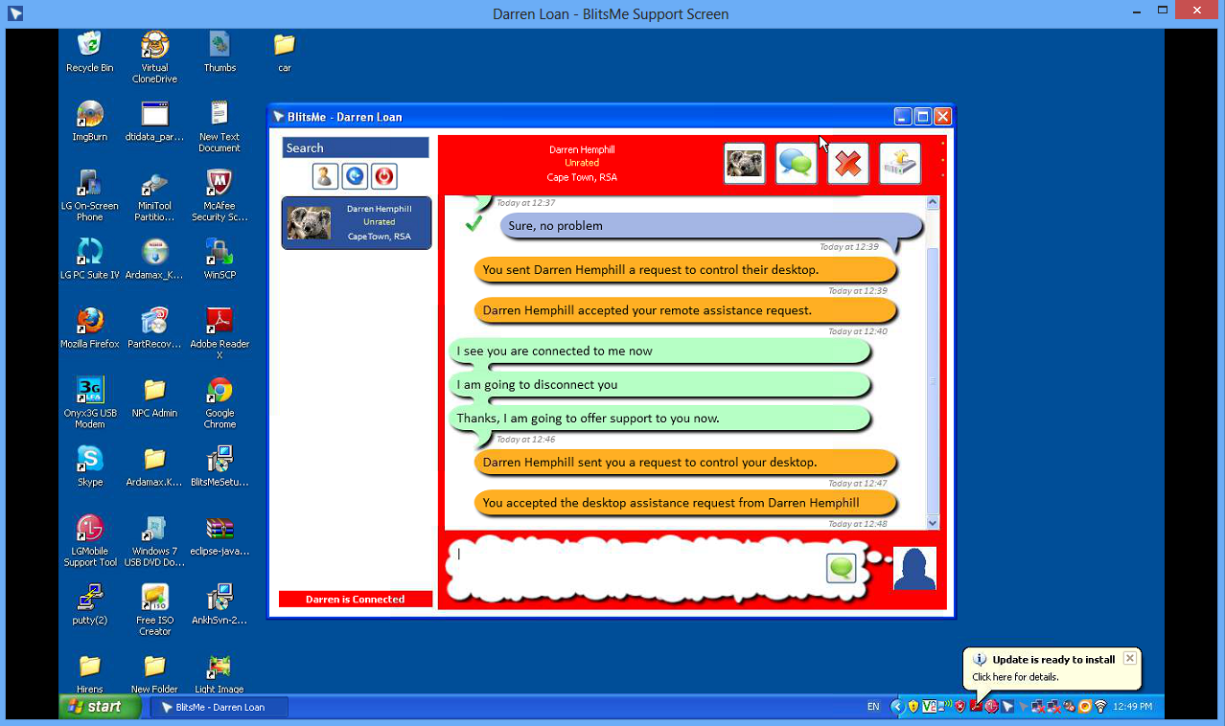
The supporter’s window into the user’s desktop

Slide 11
User A disconnects by closing the window
OR
User B can click the Disconnect Button
User B will then rate use A as before

